Slide 1
Homeless Housing Assistance & Prevention Round 5 (HHAP-5) Local Homelessness Action Plan
Presented by: Shannon Duncan
Senior Staff Analyst: Fresno County Department of Social Services
March 15, 2024

Slide 2
HHAP-5 Program Overview
HHAP-5 Purpose:
To organize and deploy the full array of homelessness programs and resources comprehensively and effectively, and
To sustain existing federal, state, and local investments towards long-term sustainability of housing and supportive services.
The overarching objective of HHAP funding remains – to effectively address and end people’s experiences of homelessness.

Slide 3
HHAP-5 Application Requirements
Overlapping jurisdictions are required to coordinate to develop a single Regionally Coordinated Homelessness Action Plan and apply together.
Jurisdictions must:
Engage key stakeholders during the development of the Action Plan. This is an ongoing process and input is taken and always encouraged.
Present the local homelessness action plan at a regular meeting of the governing bodies.
Become part of a regional Memorandum of Understanding (MOU) committing to participate in and comply with the Local Homelessness Action Plan.

Slide 4
HHAP-5 Local Homelessness Action Plan
The Local Homelessness Action Plan includes elements to address each jurisdiction’s roles and responsibilities, key strategies, and plans to address the goals of the program.
The Plan requires cooperation across all jurisdictions and includes the compilation of all efforts to end homelessness.
For this presentation, the overview will be on the FMCoC key strategies and plans.

Slide 5
HHAP-5 Partner MOU
The Regional MOU must be signed by each participating applicant committing to participate in and comply with the Local Homelessness Action Plan.
Per the MOU, changes to the Action Plan will require amendment to the MOU as the Action Plan is part of the MOU.
The MOU has been signed by the County of Madera and the City of Fresno, and pending your approval, will be signed by the County Board of Supervisors, on behalf of the County and FMCoC on March 19, 2024.
The County of Fresno serves as the Administrative Entity on behalf of the FMCoC and the County and funds are awarded in a single award, to the County of Fresno for joint administration.
Similar to serving as the Administrative Entity for funding, the FMCoC is unable to sign the MOU as it is not a legal entity.

Slide 6
HHAP-5 Local Homelessness Action Plan
Overview of Action Plan Elements:
Jurisdictions’ roles and responsibilities regarding the following:
Outreach and Site Coordination;
Summarizes the FMCoC’s Housing and Urban Development (HUD) CoC grant which funds the FMCoC Coordinated Entry System (CES) Management Entity and the Community Action Partnership of Madera H.E.L.P. Center.
Land Use and Development;
Summarizes the FMCoC role in the Point-in-Time Count and HMIS data to inform planning.
Development of Shelter, Interim, and Permanent Housing Options;
Summarizes the efforts of the FMCoC to fund Emergency shelter, rapid rehousing, and the CES Management entity to match households to these services.
Coordination of & Connection to Service Delivery;
Summarizes the FMCoC’s work through the CES Management Entity to develop policies and address system bottlenecks toward improved access and connection to services.
Notes:
More detail can be found on the Action Plan pages 1-10

Slide 7
HHAP-5 Local Homelessness Action Plan Overview of Action Plan Elements: (continued)
Participating Jurisdictions’ Key Actions to Improve:
System Performance Measures
1a: Number of people accessing services who are experiencing homelessness
1b: Number of people experiencing unsheltered homelessness on a single night
2: Number of people accessing services who are experiencing homelessness for the first time
3: Number of people exiting homelessness into permanent housing
4: Average length of time that people experienced homelessness while accessing services
5: Percent of people who return to homelessness within 6 months of exiting homelessness response system to permanent housing
6: Number of people with successful placements from street outreach projects
Addressed through FMCoC funding for continued services and connecting clients to other resources through CalAIM when appropriate.
Notes:
More detail can be found on the Action Plan pages 10-30

Slide 8
HHAP-5 Local Homelessness Action Plan Overview of Action Plan Elements: (continued)
Participating Jurisdictions’ Key Actions:
Equity Improvement Plan
Addressed through the FMCoC and partner efforts to develop a new assessment tool which will help to ensure more accurate vulnerability ratings and more appropriate matches to housing
Addressed through requesting racial equity plans from funding applicants and sharing best practices across the jurisdictions.
Notes:
More detail can be found on the Action Plan pages 10-30

Slide 9
HHAP-5 Local Homelessness Action Plan
Overview of Action Plan Elements: (continued)
Participating Jurisdictions’ Plans to:
Reduce the Number of People Experiencing Homelessness Upon Exiting an Institutional Setting
Addressed through the FMCoC work with Access sites to refer persons to CalAIM navigation to ensure they are connected with resources for housing and other assistance upon exit.
Utilize Local, State, and Federal Funds to End Homelessness
Includes all current funding and plans to support the homeless response system for the FMCoC.
Notes:
More detail can be found on the action plan on pages 30-48

Slide 10
HHAP-5 Program Eligible Activities
While the eligible uses for HHAP-5 remain largely unchanged from previous rounds, the HHAP-5 statute reorganizes eligible uses into three main buckets:
(1) costs that support permanent housing (delivery of permanent housing and innovative housing solutions, rapid rehousing, prevention and shelter diversion, operating subsidies);
(2) costs that support interim housing (operating subsidies, interim housing, improvements to existing interim housing); and
(3) costs that support service provision and systems support (street outreach, services coordination, systems support).

Slide 11
HHAP-5 Funding Overview
Combined Fresno Madera Continuum of Care Service Area award is $25.7 million.
County of Fresno - $5.2 million
Fresno Madera Continuum of Care (FMCoC) - $6.5 million
Combined Fresno-Madera Continuum of Care and County of Fresno award - $11.7 million
City of Fresno - $ 13 million
County of Madera - $1 million
A minimum of 10% ($2.6 million) must be used to provide services for homeless youth.
A maximum of 7% ($1.8 million) may be used for Administration.
Additional Supplemental funding will be available later this year, subject to spend-down and performance.

Slide 12
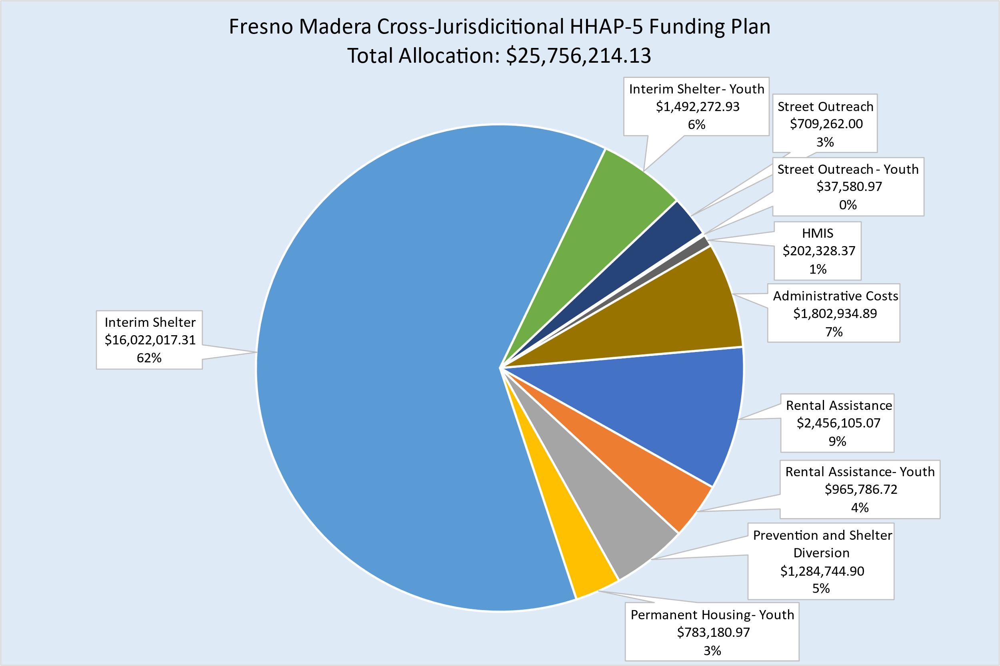
HHAP-5 Cross-Jurisdictional Funding Plan

Slide 13
County of Fresno & FMCoC HHAP-5 Funding Plan Total Anticipated Funding: $11,720,018
Rapid Rehousing (Rental Assistance & Case Management): $3,196,406 (27%)
Includes Rental Assistance & Case Management specifically for youth: $937,601 (8% of total grant)
Includes Rental Assistance & Case Management in Madera County; $403,200 (6% of the FMCoC allocation)
Prevention & Shelter Diversion: $1,172,002 (10%)
Operating Subsidies (Interim Shelter): $5,977,209 (51%)
Includes Youth Interim Shelter: $937,601 (8% of total grant)
Street Outreach (Madera County): $436,800 (7 % of the FMCoC allocation)
Homeless Management Information System (HMIS): $117,200 (1%)
Administration (County Staff): $820,401 7%
Notes:
HHAP5 funding will be used primarily to continue existing services to prevent homelessness, shelter those experiencing homelessness and provide case management and rental assistance to exit them to permanent housing. Additionally, funding will be used to recruit landlords to rent to households in the homeless response system. The activities funded fall within one of the three buckets previously noted.
Madera County funding is pulled from a total of 13% of the FMCoC grant, based on their homelessness representation in the continuum of care area.

Slide 14
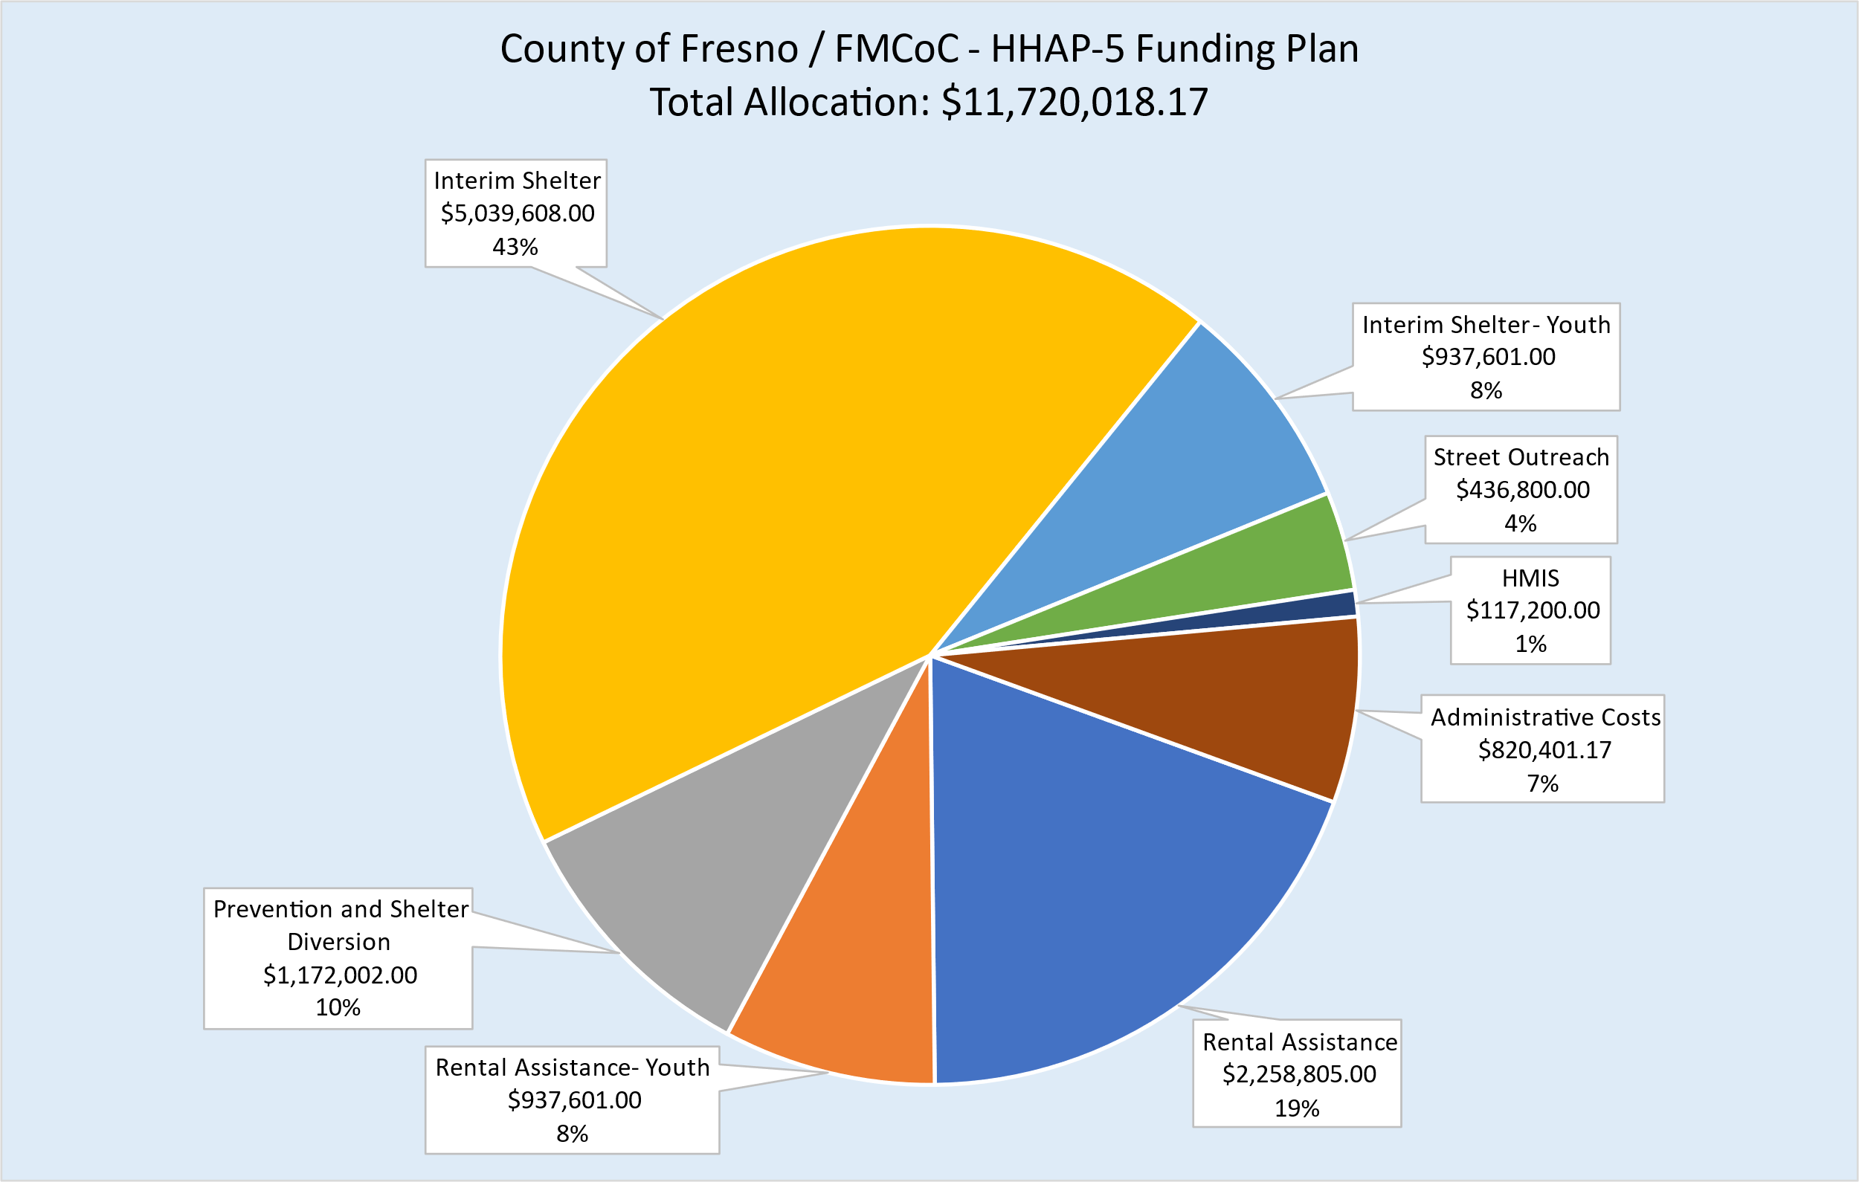
HHAP-5 County of Fresno & FMCoC Funding Plan

Slide 15
Next Steps
Upon FMCoC approval of the Action Plan and MOU, the County Board of Supervisors will execute the MOU on behalf of the FMCoC and the plan will be presented for public comment on March 17, 2024.
A single application on behalf of the jurisdictions will be submitted to the State by March 29, 2024.
Upon approval of the application, the state will issue an agreement for the funding, which will be executed by the County of Fresno Board of Supervisors on behalf of the FMCoC and County
HHAP-5 funded agreements will be awarded (through the recent Request for Proposals); Agreements will be brought to the County Board of Supervisors in May and June of 2024.
The regional partners will convene to continue to work to end homelessness and make plans for potential additional funding.
Notes:
RE HHAP-5 funded Agreements (bullet 3): The County will work closely with providers to ensure outcome goals are met and system improvements are made as needed to remove barriers to housing.
Following the submission of the application (bullet 4)
To evaluate remaining needs in the community, including incorporating community feedback into funding plans, service delivery and design
To develop a plan for HHAP-5 bonus funding
To implement racial equity improvement strategies across the community
To leverage funding across jurisdictions to maximize the impacts to services in the community

