Slide 1
FY 2021 System Performance Measures Part I
Presented by: Nicole Henson

Slide 2
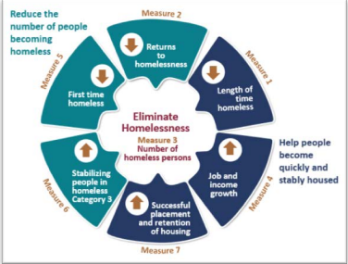
System Performance Measures
The SPMs are designed to measure a community’s performance as a coordinated entry system.
There are 7 System Performance Measures
Measure 1: Length of Time Homeless
Measure 2: Returns to Homelessness
Measure 3: Number of Homeless Persons
Measure 4: Job and Income Growth
Measure 5: First Time Homeless
Measure 6: Stabilizing people in homeless Cat 3 (We arent measured on this)
Measure 7: Successful placement and retention of Housing
* Data Quality ☺

Slide 3
Measure 1: LOT Homeless

Slide 4
Measure 2: Returns to Homelessness

