Slide 1
FY 2021 Sheltered Homelessness
Presented by Nicole Henson
HMIS System Administrator
February 10, 2022

Slide 2
2021 PIT Sheltered Homeless
On the night of January 28, 2021, people experiencing homelessness who were sheltered in emergency shelter and transitional housing…
106 Households
(332 Total Persons)
Emergency Shelter
893
Transitional Housing
106
Total Sheltered Homeless
999
561 Single Persons
18 Households
(52 Total Persons)
54 Single Persons

Slide 3
FY 2021 Total Clients Served
Emergency Shelter- 2959
2464 Singles (Adults Only)
476 Children and Adults(138 Households)
18 Youth
Transitional Housing- 611
186 Single (Adults Only)
425 Children and Adults (115 Households)
*HMIS Data Only

Slide 4
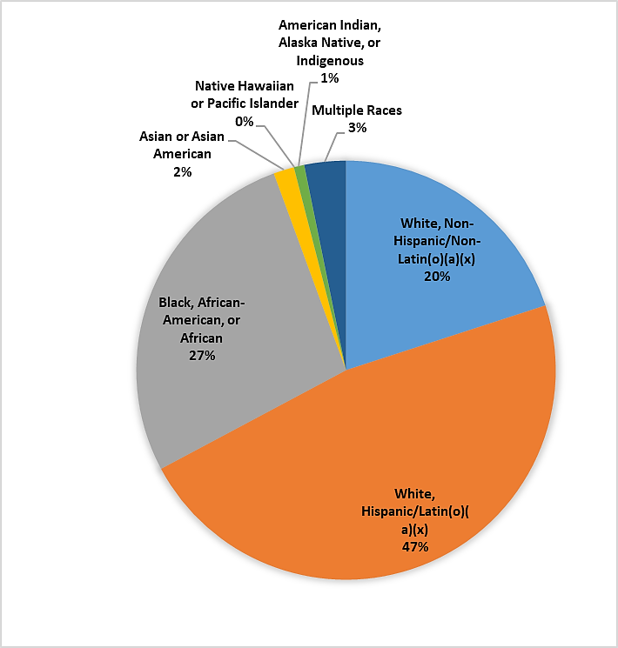
Transitional Housing Family Demographics
6 TH Projects serve Families (Total 9)
47% HoHs- White, Hispanic/Latin(o)(a)(x) Females
74% Female HoH
Average Household Size: 4
Average Monthly Income: $500-1500
Average Project Stay: 141 Days
*HMIS Data Only

Slide 5
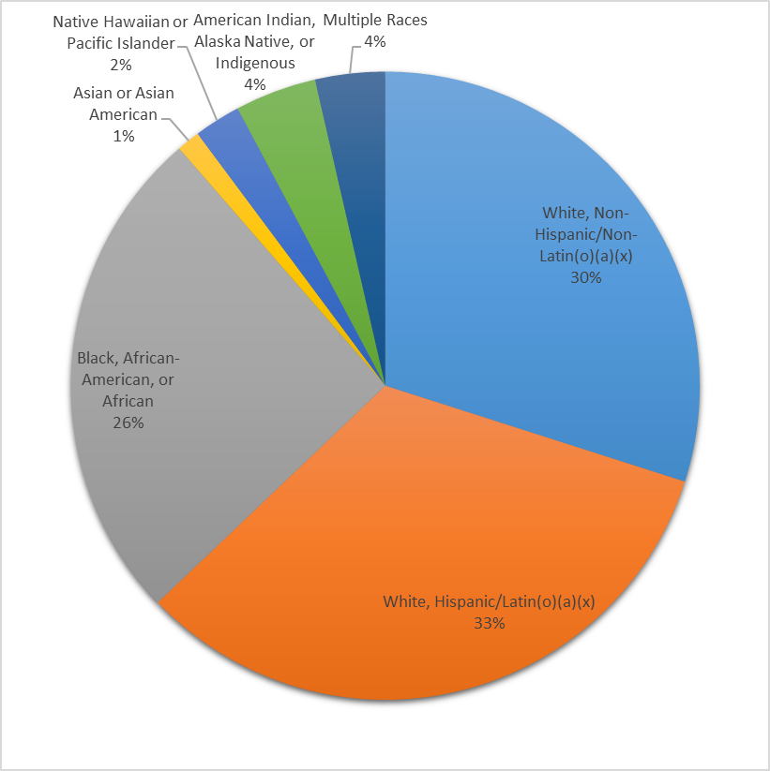
Transitional Housing Adult Only HH Demographics
3 TH Projects serve Adult Only Households (Total 9)
66% Male HoH
Average Household Size: 1
Primary Sources of income: Disability Income (SSI, SSDI, VA Disability)
Average Project Stay: 138 Days
*HMIS Data Only

Slide 6
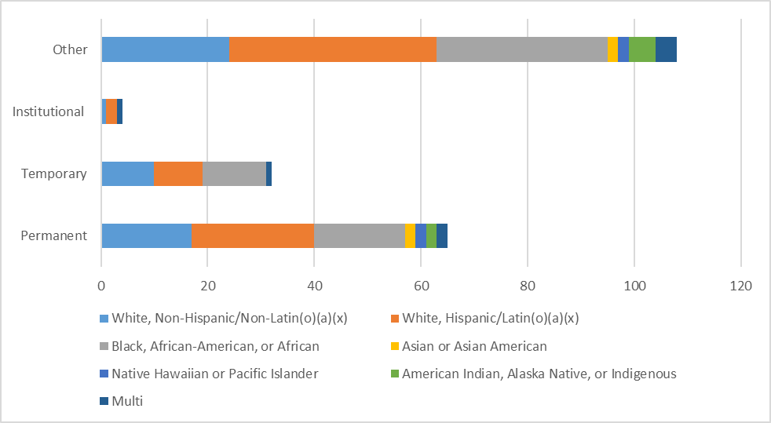
Exits from Transitional Housing

Slide 7
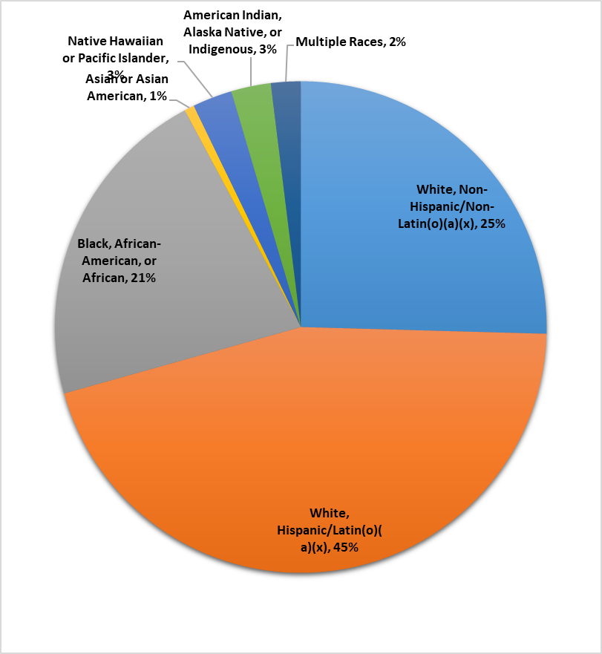
Emergency Shelter Family Demographics
9 ES Projects serve Families (Total27)
31% Prior Living Situation-Place not meant for habitation
80% HoH Females
44% HoH White, Hispanic Female
Average Household Size: 3
Average Monthly Income: $882
Average Project Stay: 96.5 Days

Slide 8
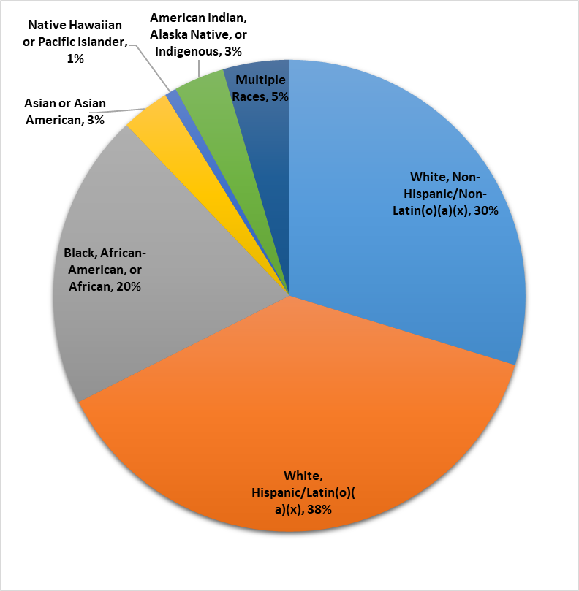
Emergency Shelter Adult Only HH Demographics
18 ES Projects serving Adults Only (Total27)
Average Monthly Income: $421
Average Project Stay: 76.5 Days

Slide 9
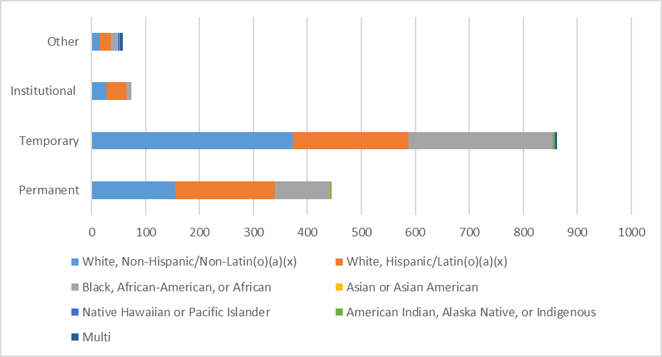
Exits from Emergency Housing

Slide 10
FMCoC Two-Year Initiative
Reduce family homelessness, as defined by adults with minor children, by 35% by December, 2023
Reduce single adult homelessness by 20% by December 2023
More Qualitative Data
Additional HMIS Data Entry (case notes, service transactions)
Inclusion of CES Project Data
Non-HMIS participating projects enter into HMIS

